Slide 1
Automated Reaction Mechanism Discovery with AutoMeKin2021
Emilio Martínez-Núñez
Department of Physical Chemistry
Universidade de Santiago de Compostela
SPAIN

Slide 2
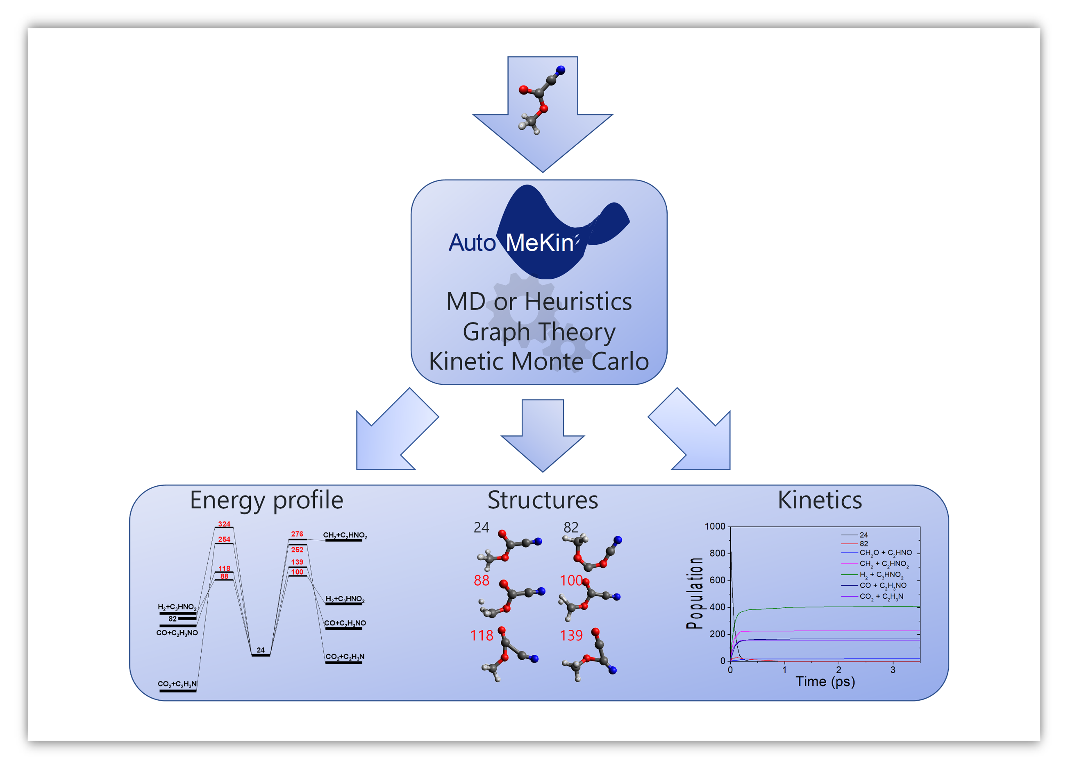
Automated Reaction Mechanism Discovery with AutoMeKin2021
AutoMeKin (Automated Mechanisms and Kinetics)

Slide 3
Automated Reaction Mechanism Discovery with AutoMeKin2021
AutoMeKin: Motivation
Manual search is not efficient
Possible non-intuitive pathways

Slide 4
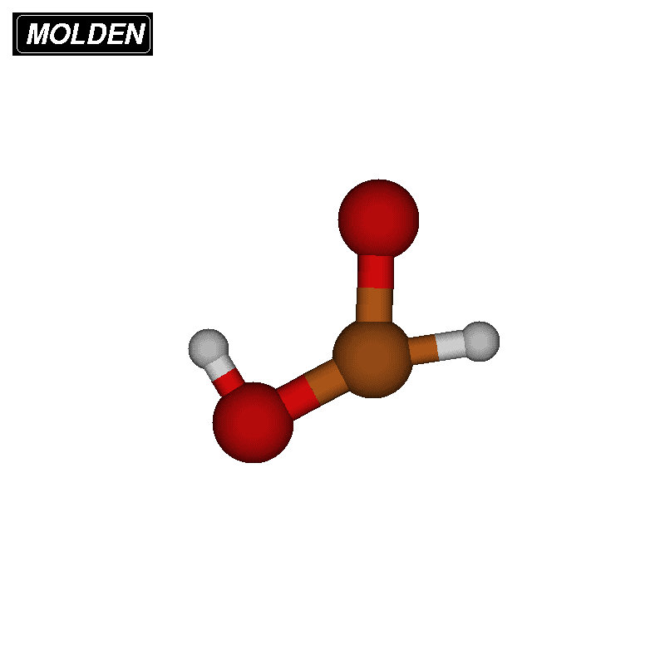
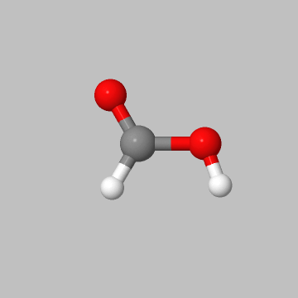
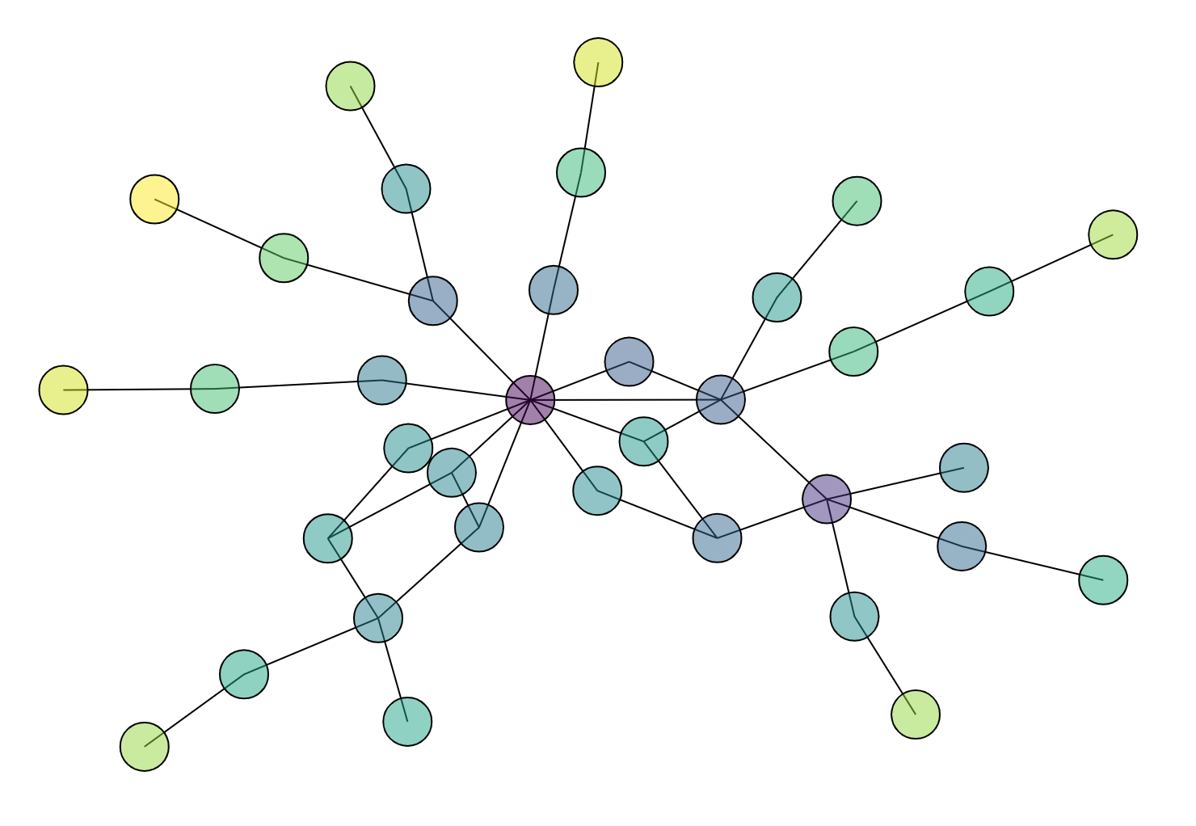
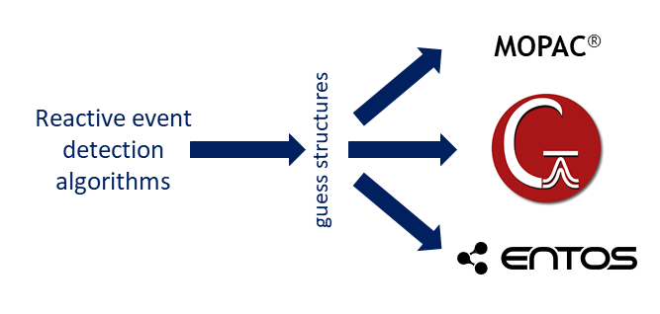
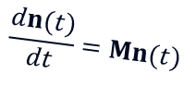
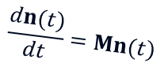
Automated Reaction Mechanism Discovery with AutoMeKin2021
AutoMeKin: Workflow
Geometry
MD
Heuristics
TS opt
CRN
Kinetics
SQM
$$\frac{dn(t)}{dt}=Mn(t)$$
TS opt
CRN
Kinetics
DFT or ab initio
$$\frac{dn(t)}{dt}=Mn(t)$$

Slide 5
Automated Reaction Mechanism Discovery with AutoMeKin2021
MD simulations
Phys. Chem. Chem. Phys. 2015,17, 14912
Standard MD: high E or T and short:
QCT
Microcanonical/canonical sampling
Adaptive energy range
Movie: 210 kcal/mol

Slide 6
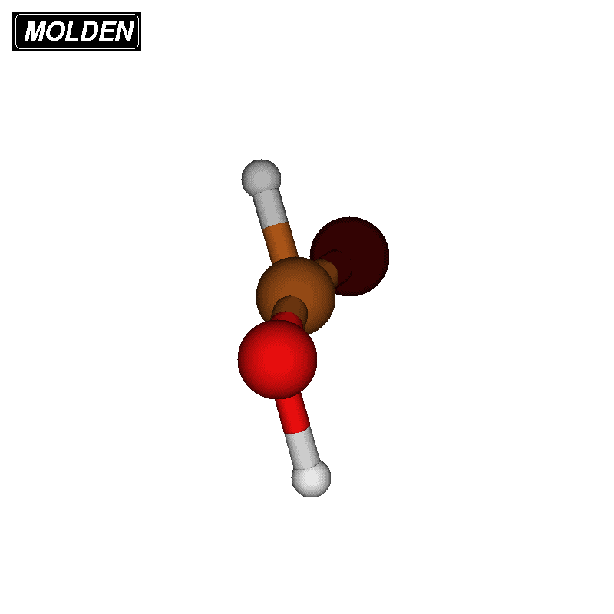
Automated Reaction Mechanism Discovery with AutoMeKin2021
MD simulations
ChemSystemsChem 2020, 152, e19002
Rare-event acceleration method (BXDE):
Energy boxes
More efficient sampling
Loose coupling via ASE
Movie: Langevin 1000 K

Slide 7
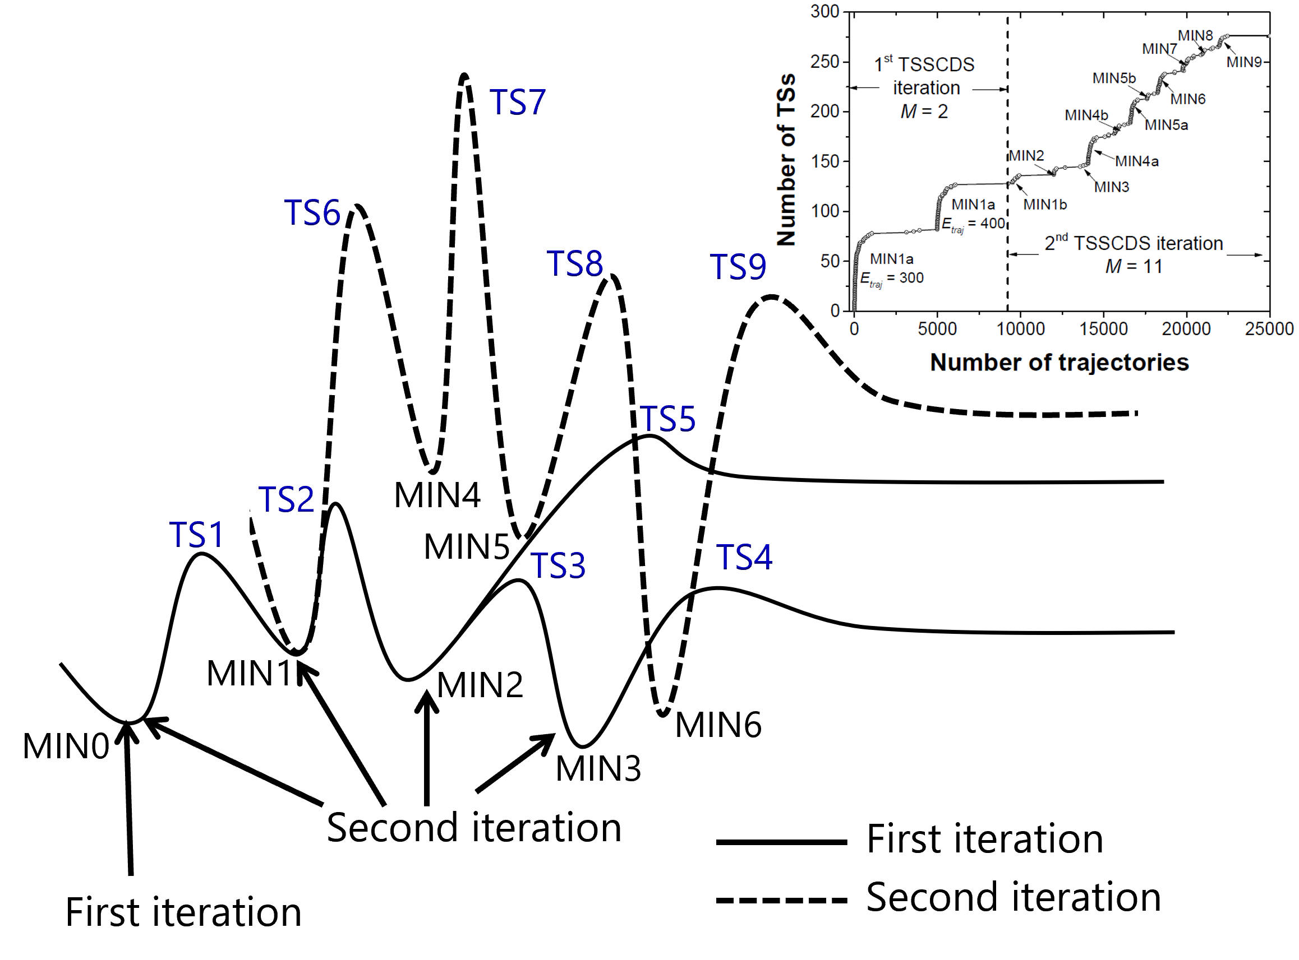
Automated Reaction Mechanism Discovery with AutoMeKin2021
Sampling from multiple minima
Phys. Chem. Chem. Phys. 2015,17, 14912

Slide 8
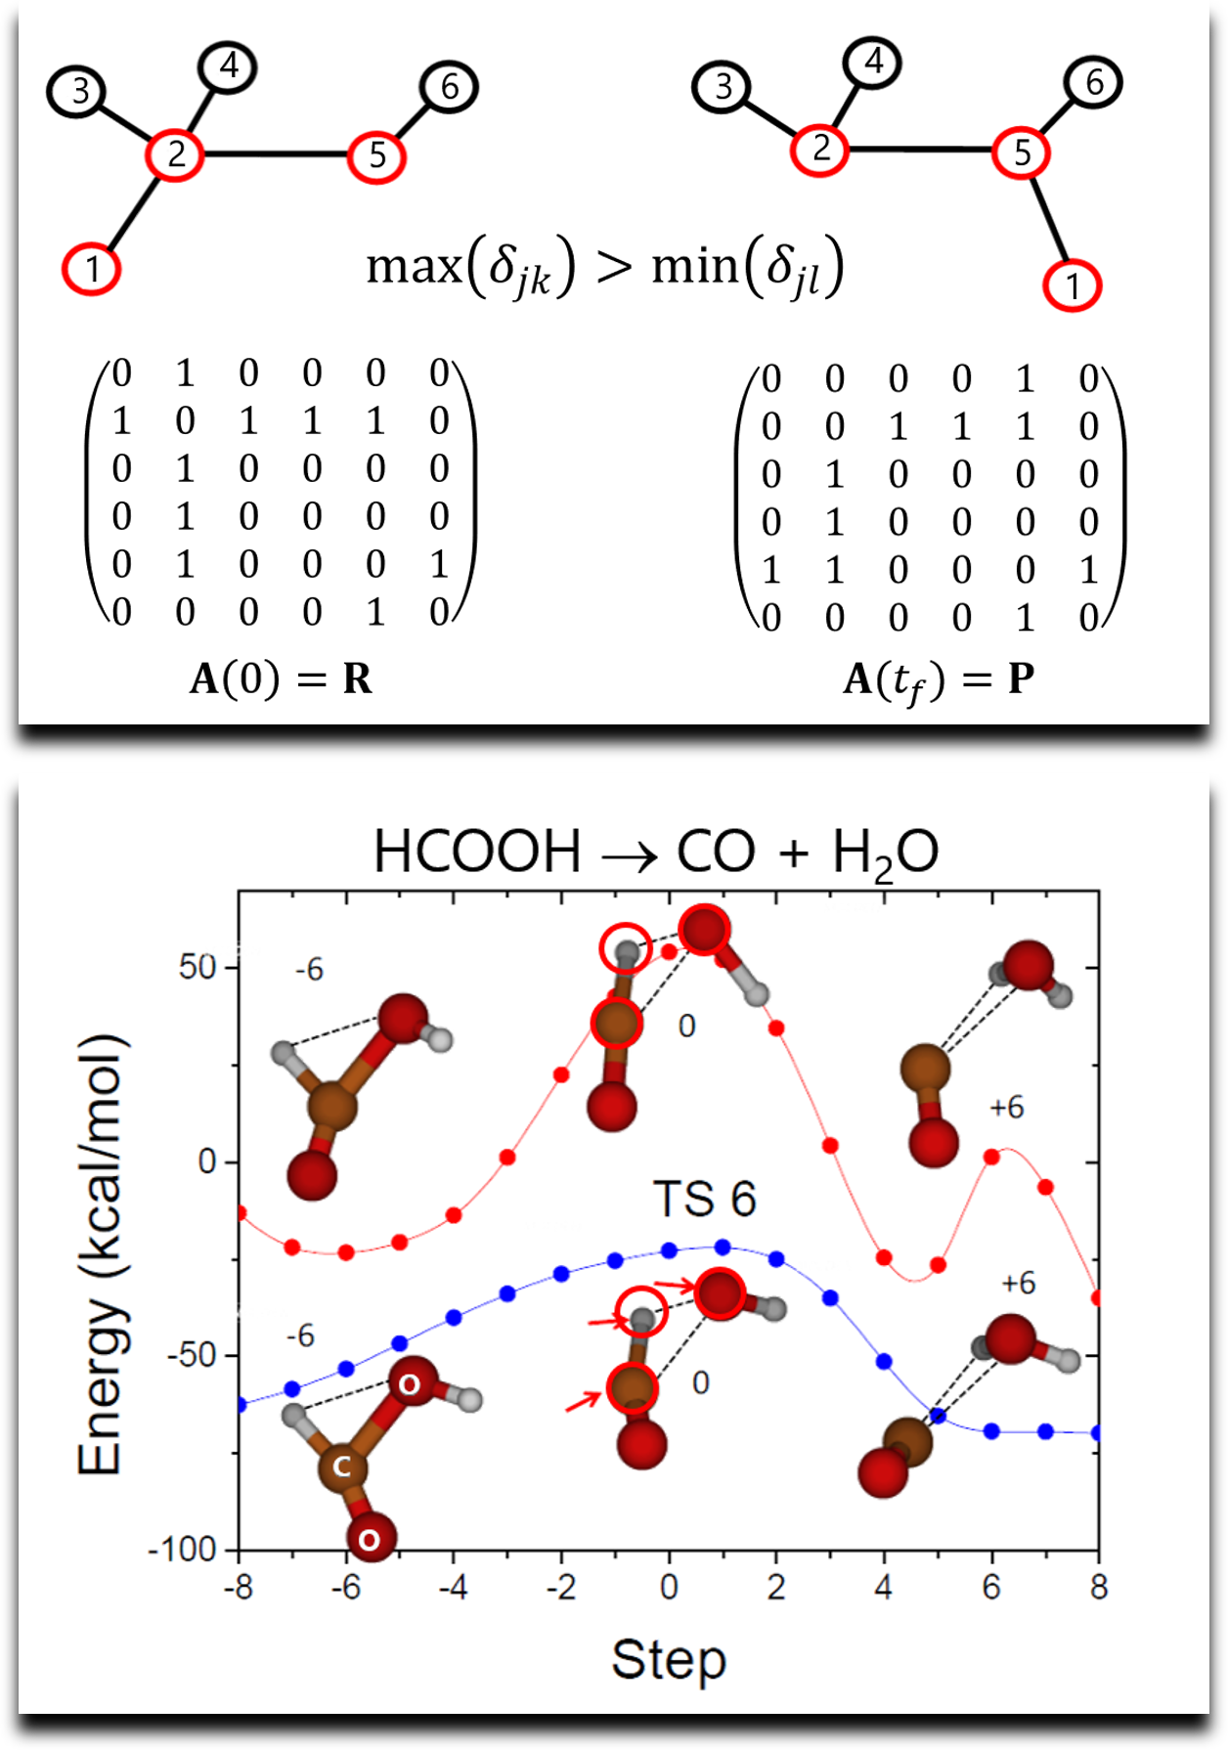
Automated Reaction Mechanism Discovery with AutoMeKin2021
What’s different from other methods?
J Comput. Chem. 2015, 36, 222
Detecting Transition States
Multiple minima
Spectral Graph Theory
Compare structures
Degree of fragmentation
Graph-based detection step
Relaxation step
Notes:
Weighted adjancency matrix

Slide 9
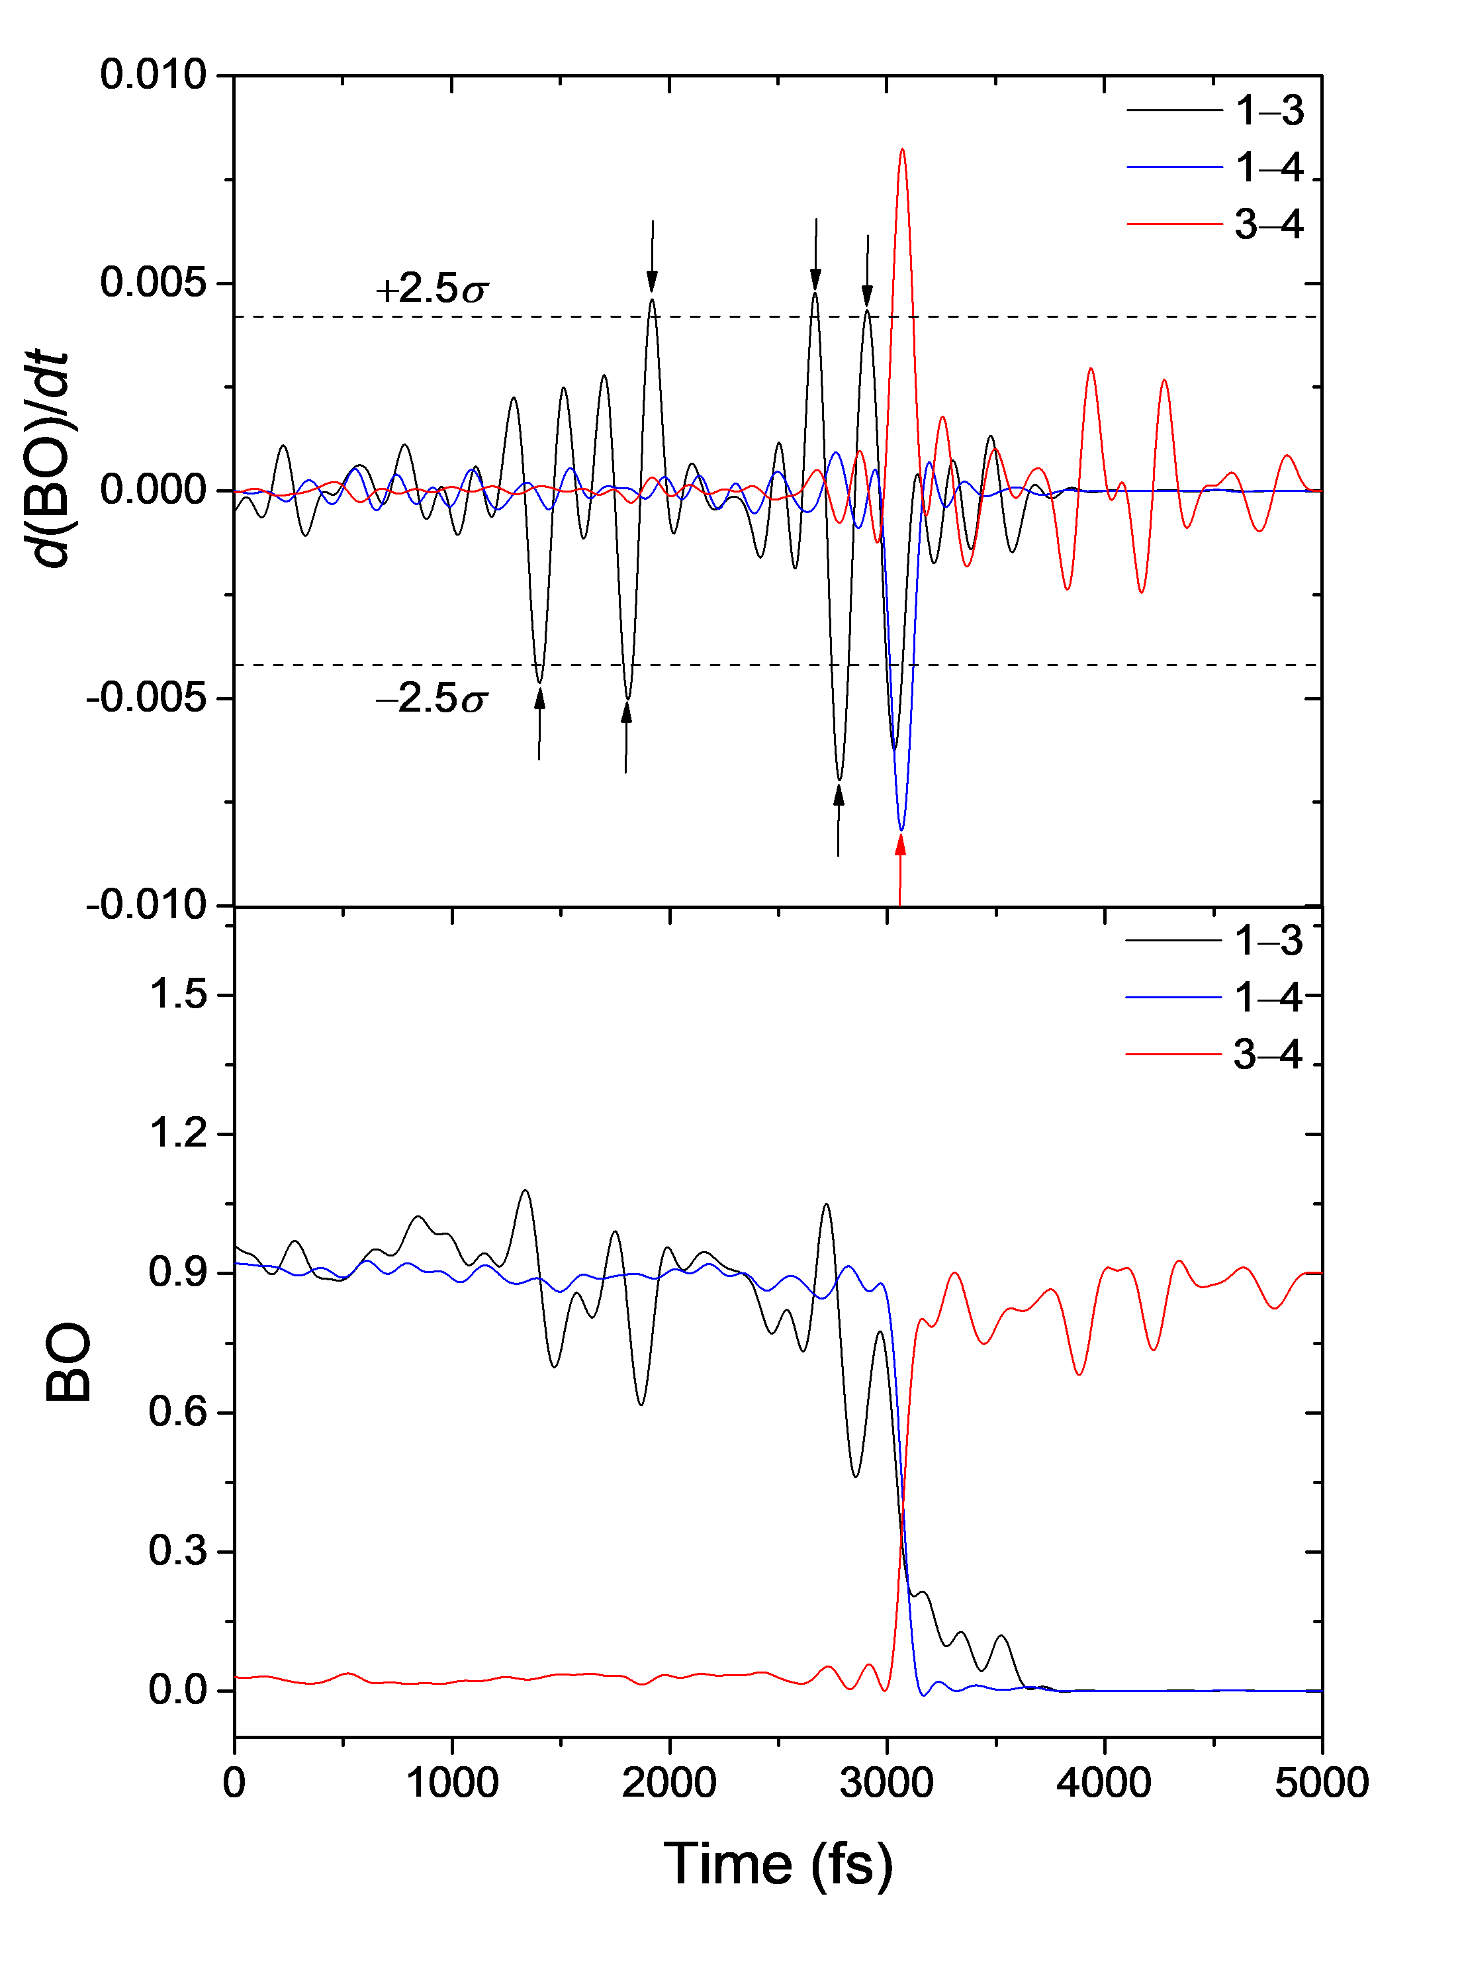
Automated Reaction Mechanism Discovery with AutoMeKin2021
Event detection: Bond orders
JCTC, 2020, 16, 1606

Slide 10
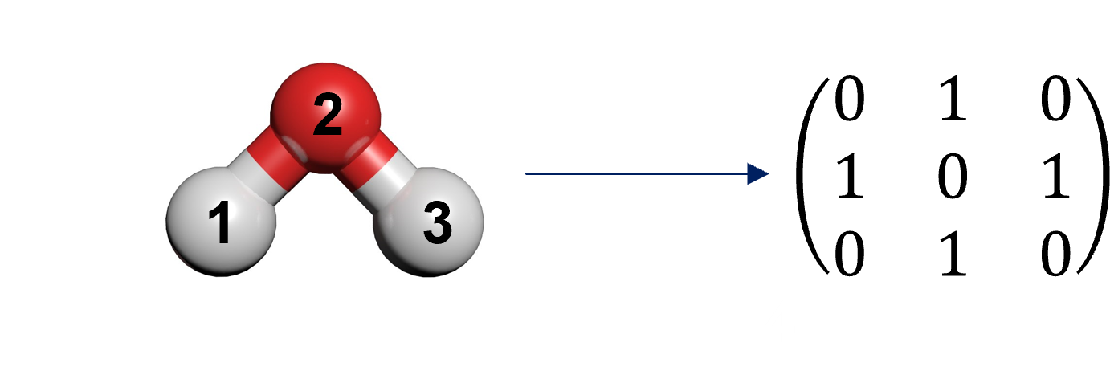
Automated Reaction Mechanism Discovery with AutoMeKin2021
ChemKnow module
J Comput. Chem. 2021, 42, 2036
Graph space
Workflow

Slide 11
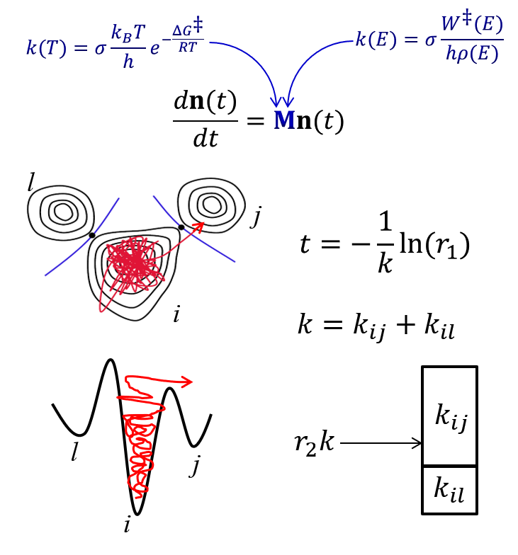
Automated Reaction Mechanism Discovery with AutoMeKin2021
Semi-automated kinetics
Automated

Slide 12
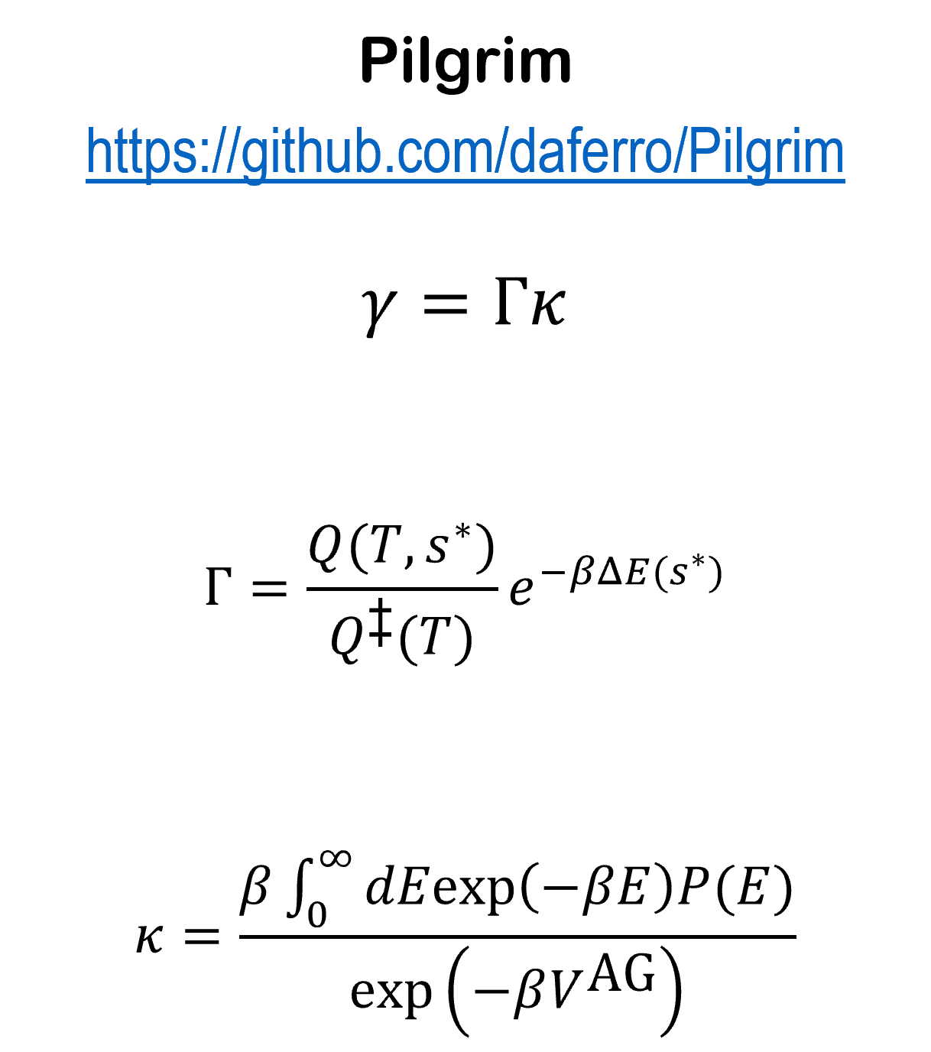
Automated Reaction Mechanism Discovery with AutoMeKin2021
Semi-automated kinetics
Not automated

Slide 13

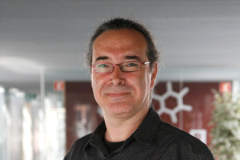
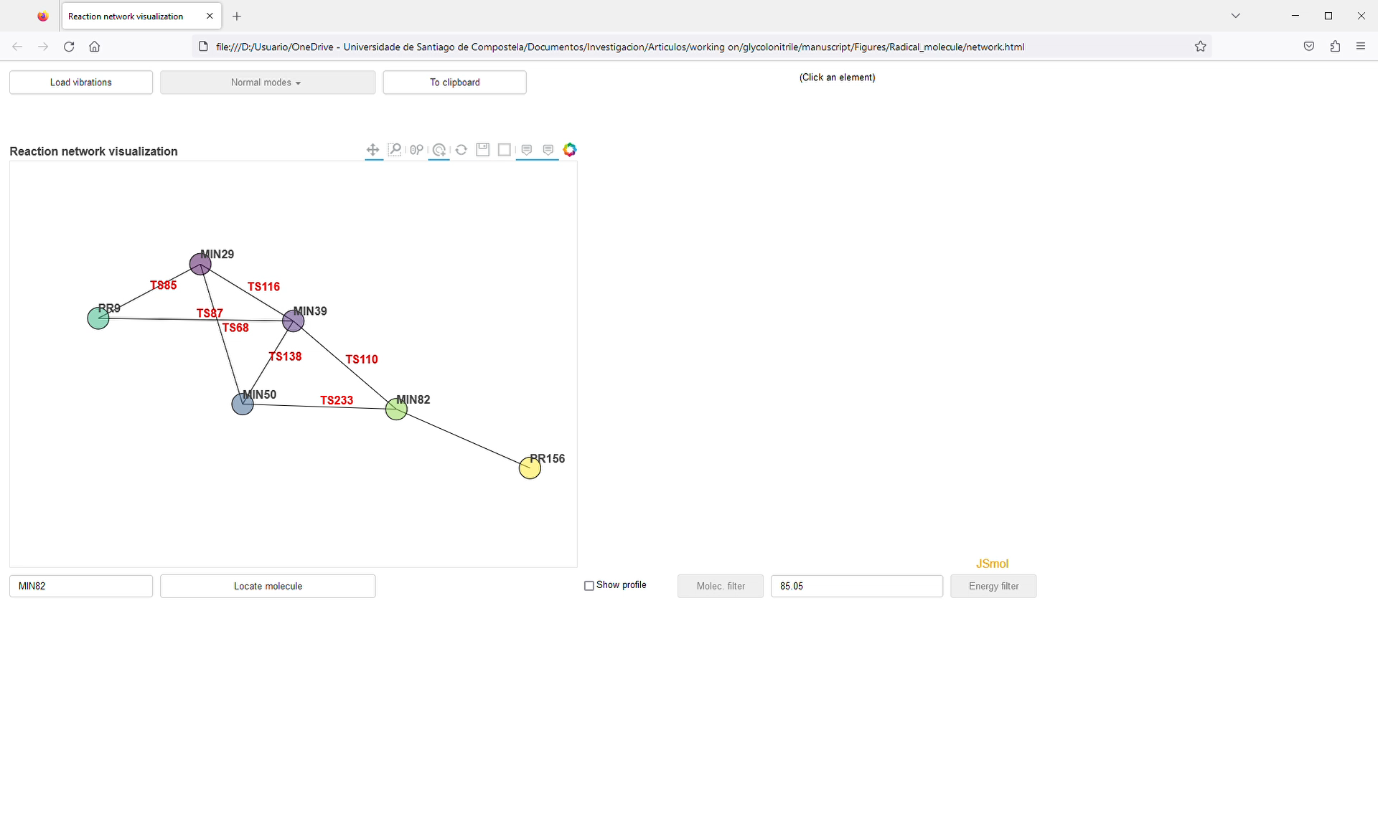
Automated Reaction Mechanism Discovery with AutoMeKin2021
Last version (2021_rev1135)
ACS Phys. Chem. Au 2022, 2, 225
Diego Garay
Carles Bo
Web server. GitHub & Sylabs.
amk_tools
Carles Bo & Diego Garay (ICIQ)
Command line & Interactive HTML

Slide 14
Automated Reaction Mechanism Discovery with AutoMeKin2021
AutoMeKin: Applications
Astrochemistry.
Non-covalent interactions.
Homogeneous catalysis.
Atmospheric chemistry.

Slide 15
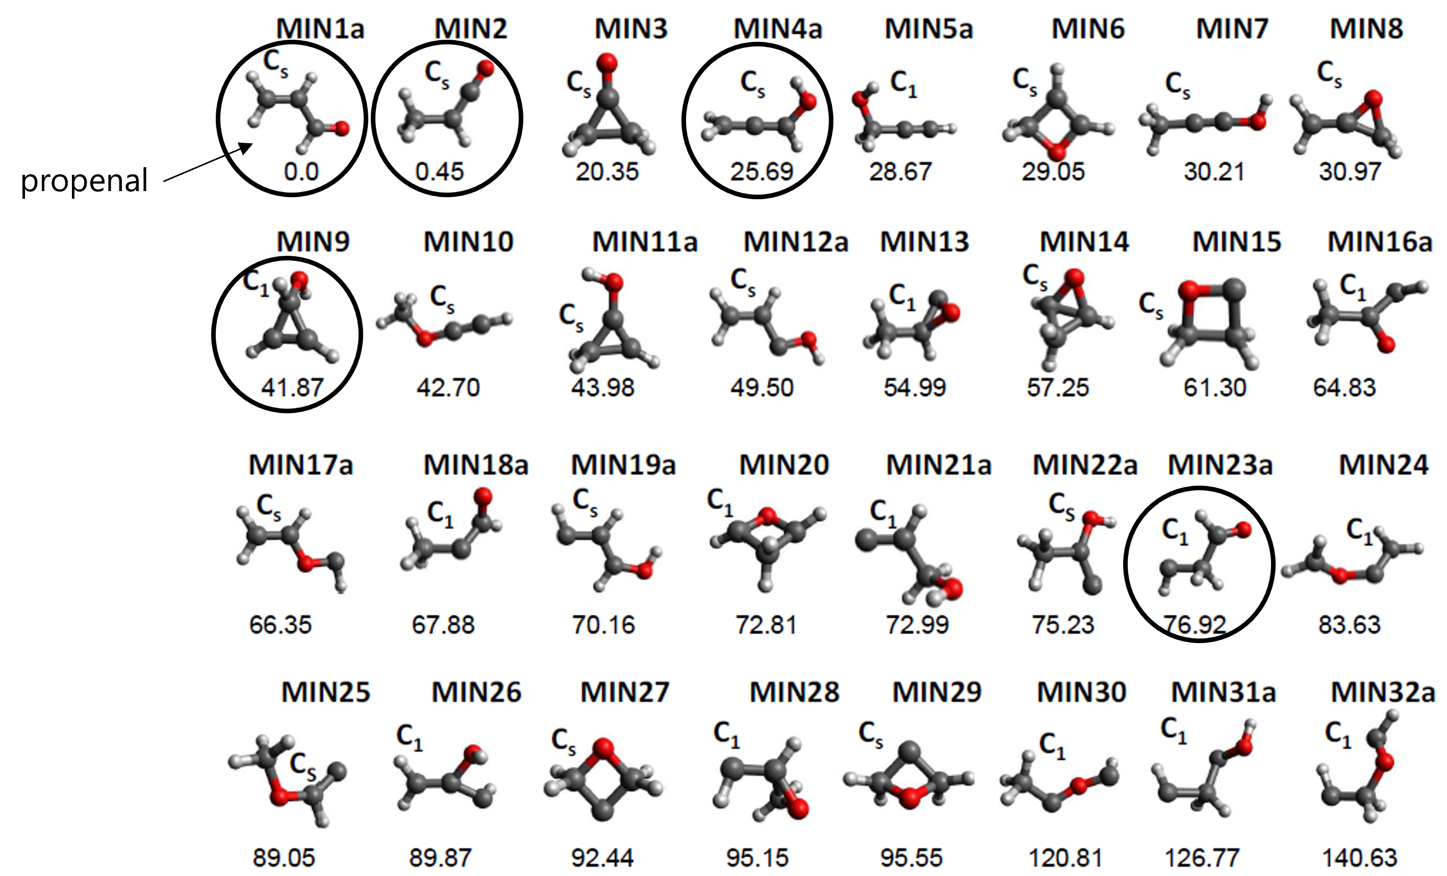
Automated Reaction Mechanism Discovery with AutoMeKin2021
Isomers of propenal
PCCP 2015, 17, 14912
JCP 2011, 134, 044309 CCSD(T)/6-311+G(3df,2p)//B3LYP/6-311G(d,p)

Slide 16
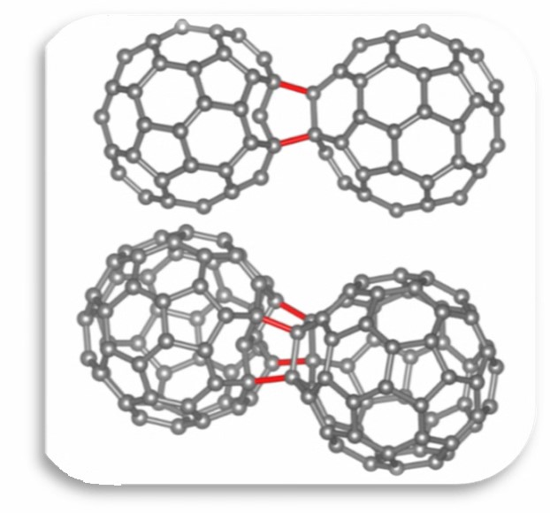
Automated Reaction Mechanism Discovery with AutoMeKin2021
Dimerization of C₆₀
Carbon 2023, 213, 118209
DFT with dispersion: TPSS-Def2-TZVPP-D3BJ/B3LYP-6-31G(d,p)-D3BJ
41 dimers (previously 12).
At 298 K C₆₀ is a van der Waals solid
Subjected to HPHTs molecules bond to each other covalently.
< 8 GPa
> 8 GPa

Slide 17
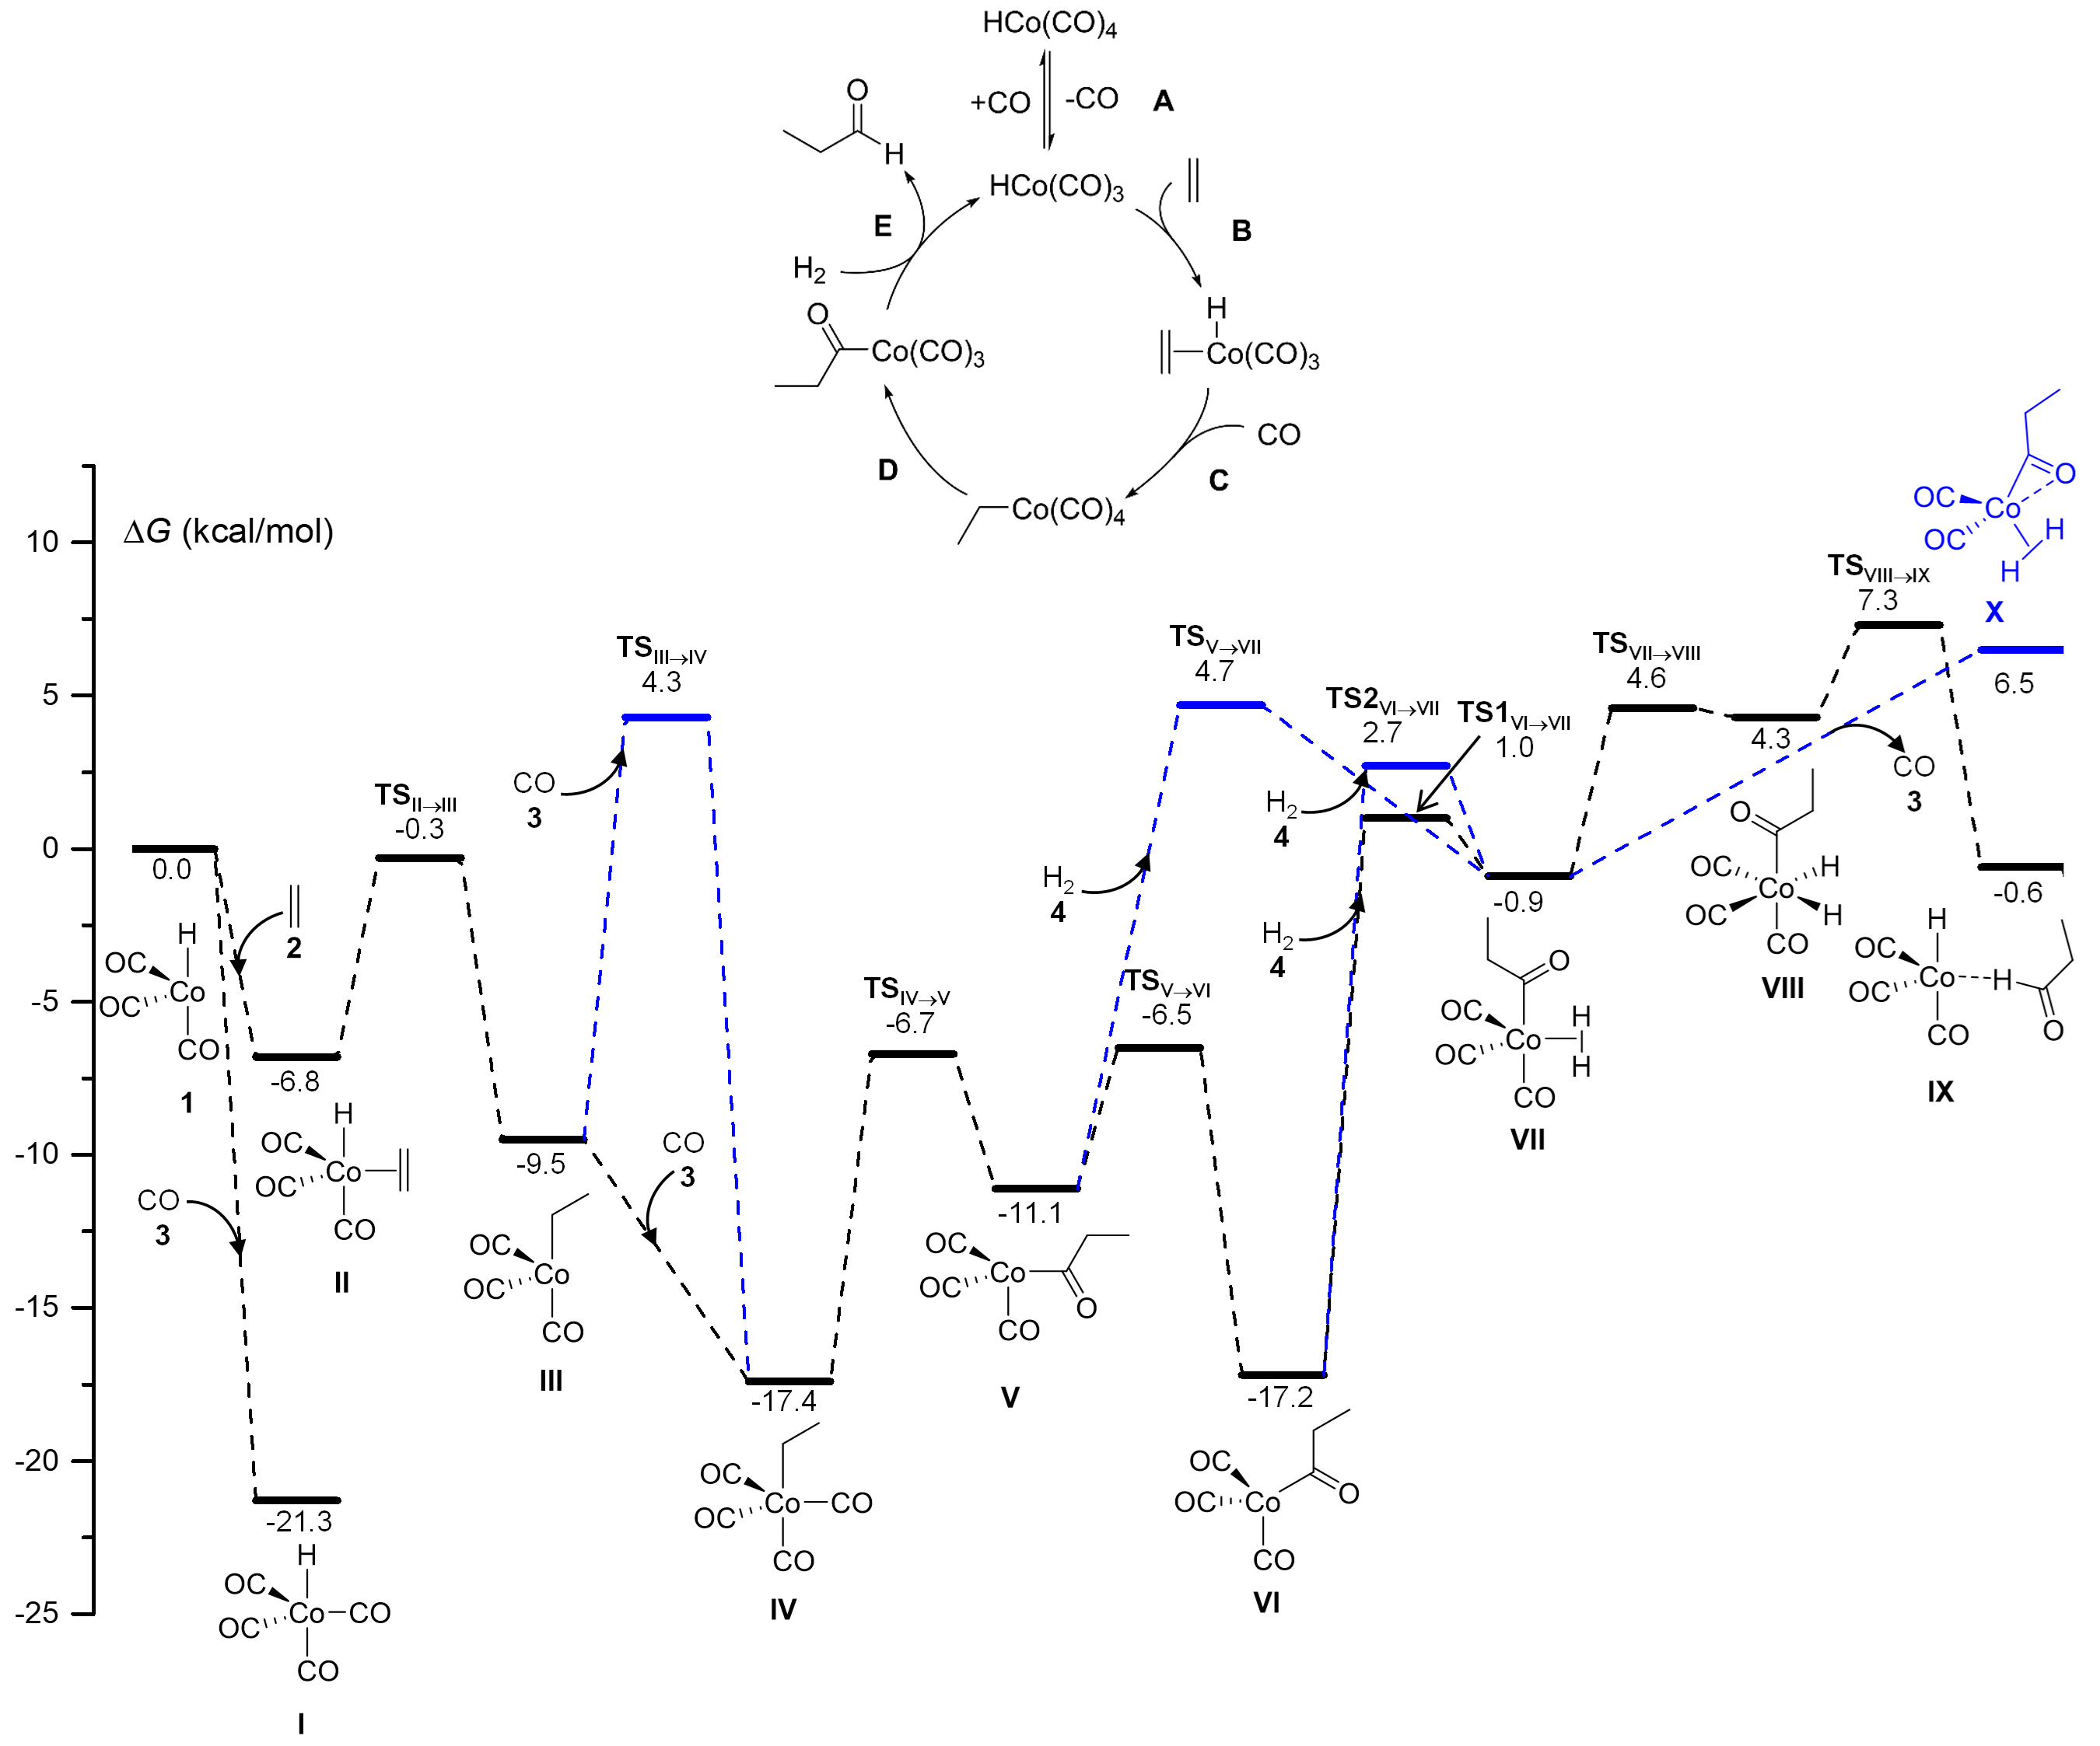
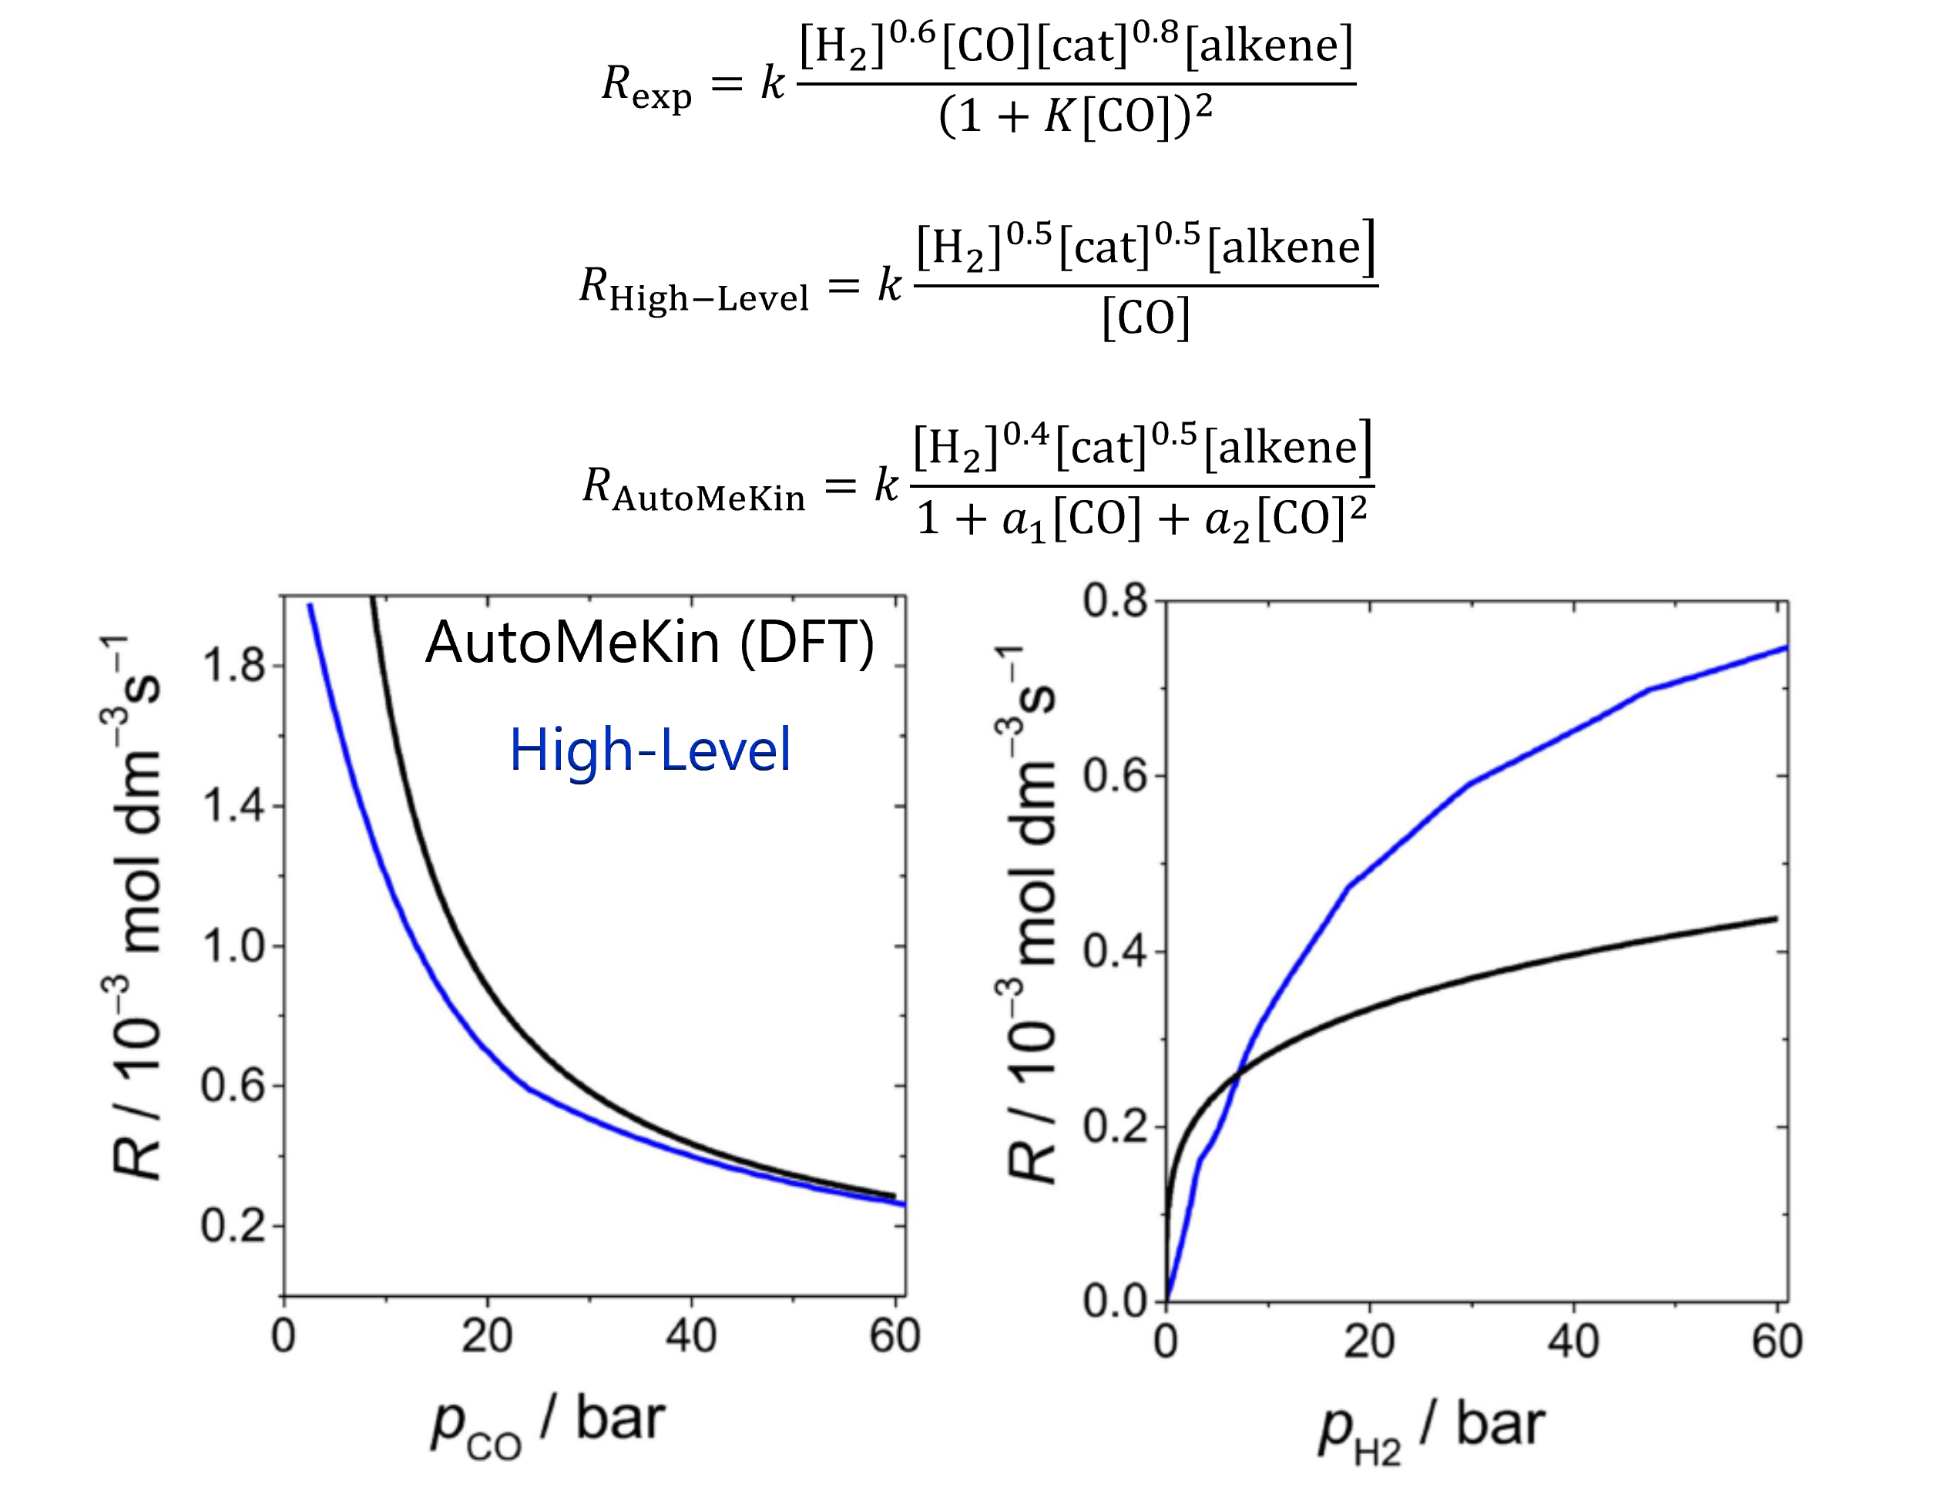
Automated Reaction Mechanism Discovery with AutoMeKin2021
Hydroformylation of ethylene
Chem. Sci. 2017, 8, 3843
Reaction mechanism
Rate law

Slide 18
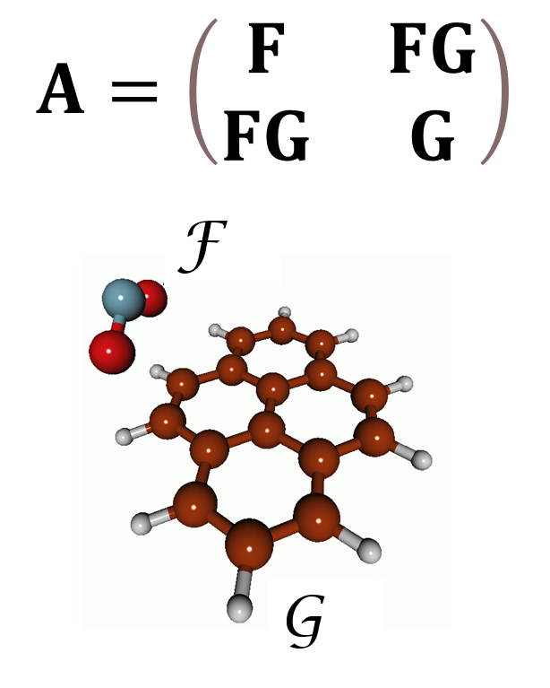
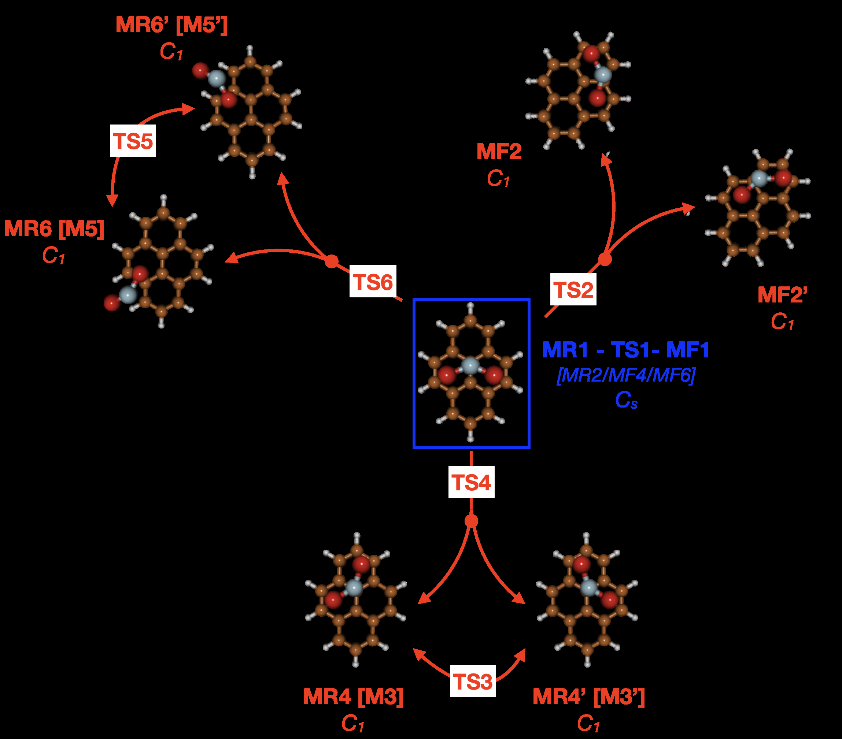

vdW interactions
Automated Reaction Mechanism Discovery with AutoMeKin2021
Int. J. Quantum Chem. 2019, 119, e26008
New A matrix
$F$: Molecule F
$G$: Molecule G
NO₂-pyrene
Most stable minimum-energy structures

Slide 19
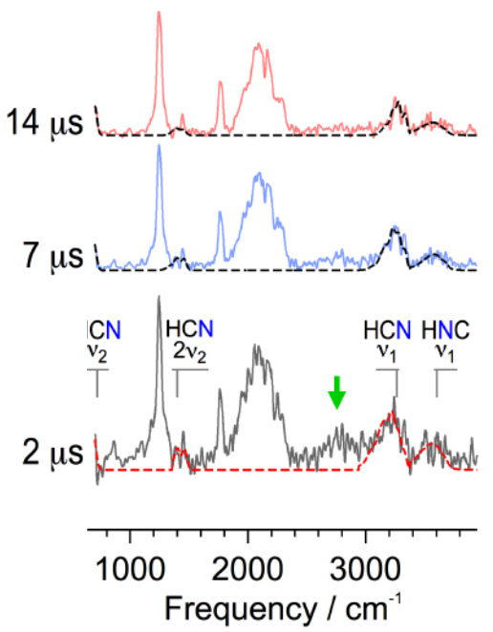
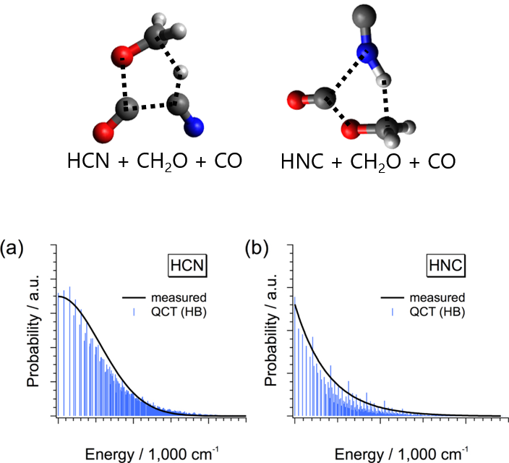
Automated Reaction Mechanism Discovery with AutoMeKin2021
Photolysis of methyl cyanoformate
Time-resolved IR spectra
Evidence of HCN(HNC) formation
ApJ. 2017, 849, 15
AutoMeKin & QCT
TSs & Vibrational distros

Slide 20
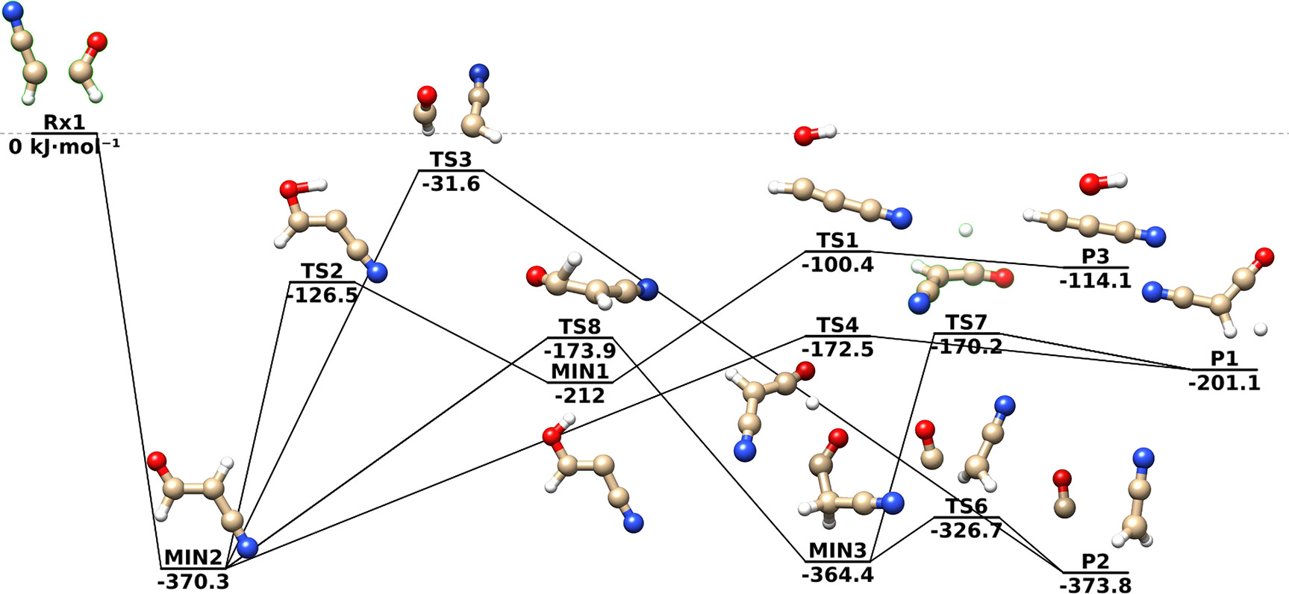
Automated Reaction Mechanism Discovery with AutoMeKin2021
Formation of cyanoketene in the ISM
ACS Earth Space Chem. 2023, 7, 1172
Reaction mechanisms
Product abundances
10-600 K: P1 > P2 > P3

Slide 21
Automated Reaction Mechanism Discovery with AutoMeKin2021
Cyanide + vinyl alcohol in the ISM
PCCP 2023, 25, 22840
Vinyl cyanide
Cyanoacetaldehyde

Slide 22
Automated Reaction Mechanism Discovery with AutoMeKin2021
Formation of glycolonitrile in the ISM
PCCP 2023, 25, 20988

Slide 23

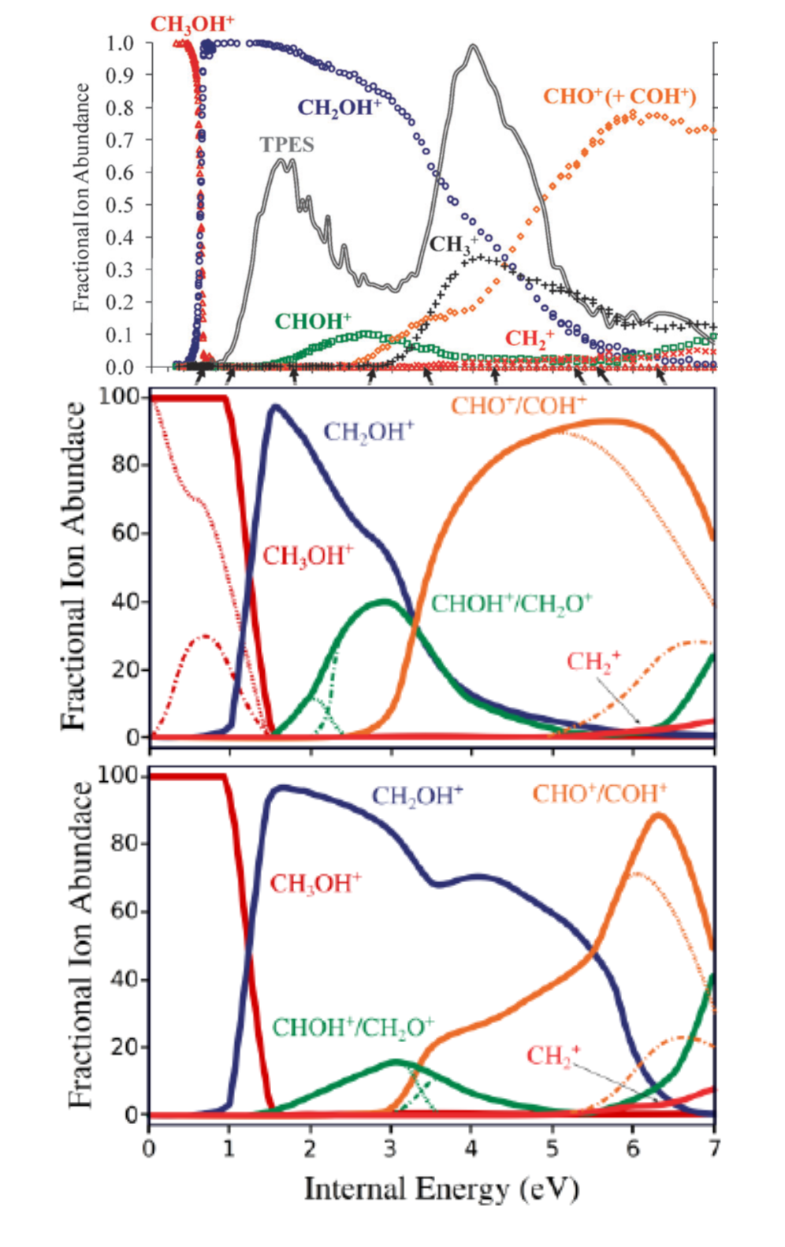
Dissociative photoionization
Automated Reaction Mechanism Discovery with AutoMeKin2021
Exp
Néstor Aguirre
M3C
M3C+AutoMeKin

Slide 24
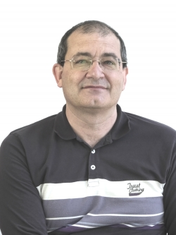

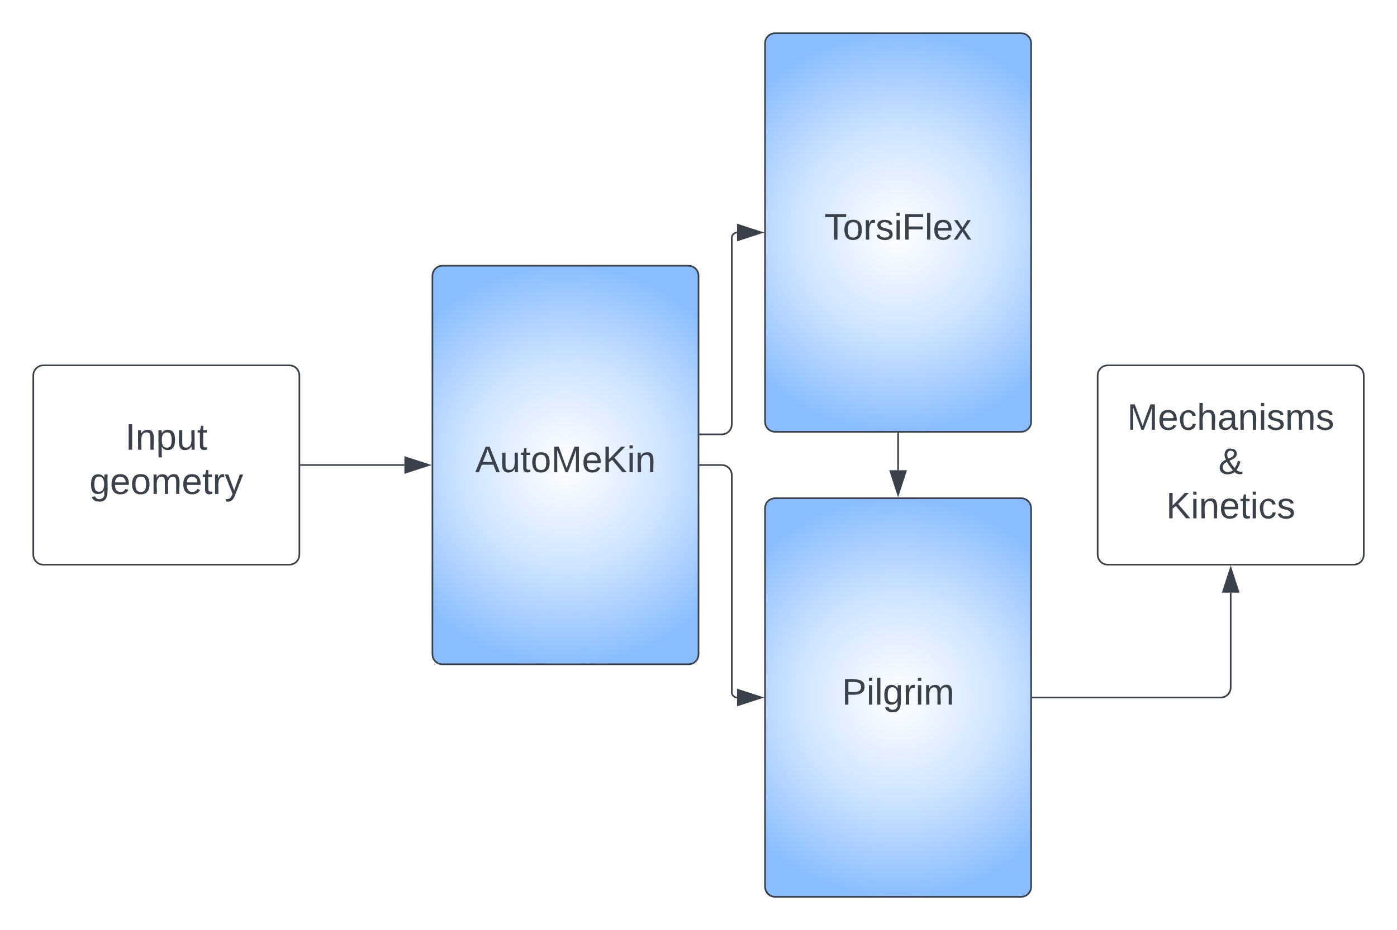
Automated Reaction Mechanism Discovery with AutoMeKin2021
Integration within the Cathedral package
https://github.com/cathedralpkg
Antonio
Fernández-Ramos
David Ferro

Slide 25
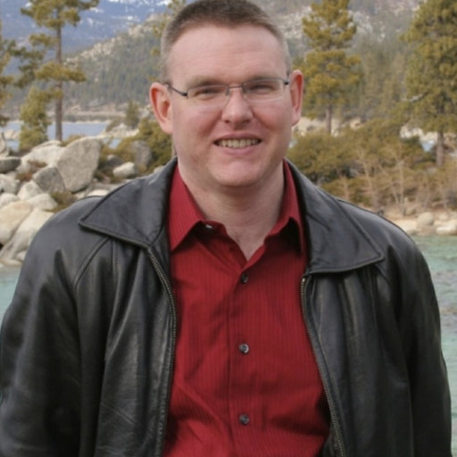

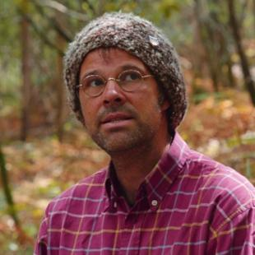

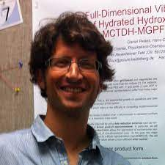
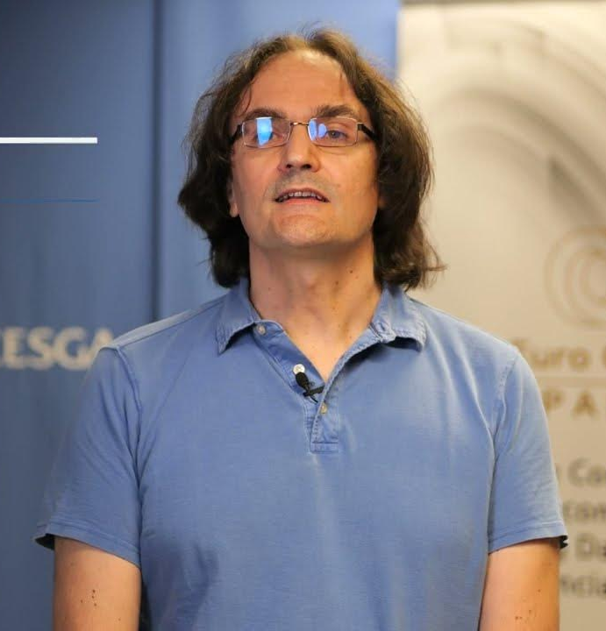
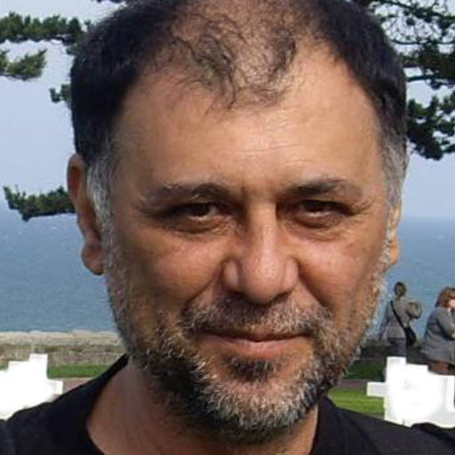
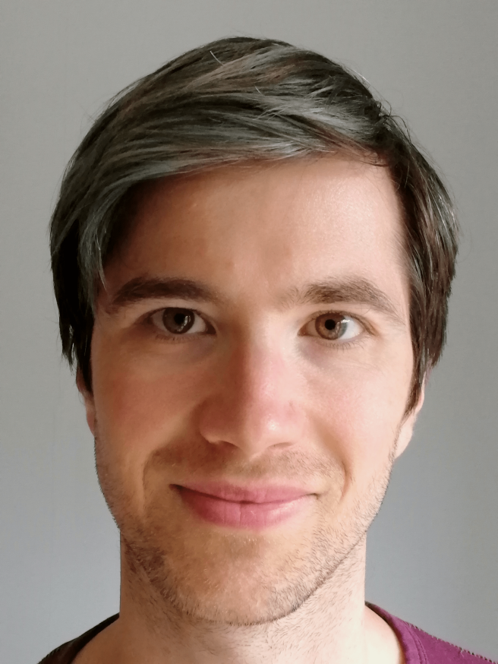
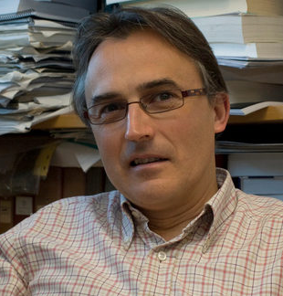
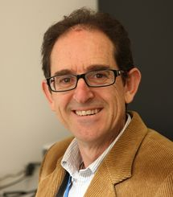

Automated Reaction Mechanism Discovery with AutoMeKin2021
Acknowledgements
George Barnes
Carles Bo
Diego Garay
Dave Glowacki
Sabine Kopec
Dani Peláez
Aurelio Rodríguez
Roberto Rodríguez
Robin Shannon
Pablo Tahoces
Saulo Vázquez

Slide 26
ML-based reaction barriers
J Phys. Chem. A 2023, 127, 2274
Workflow
Predictions
Learning curves
Bespoke predictors rank high

Slide 27
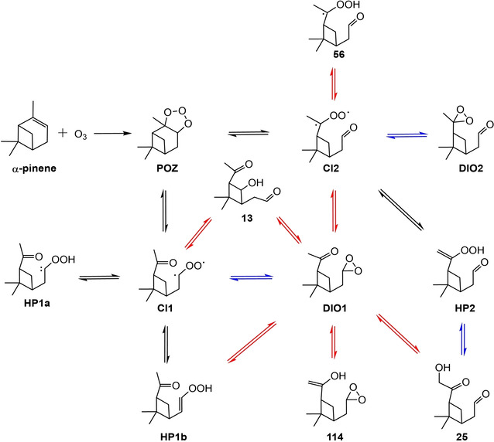
Ozonolysis of α-pinene
ChemSystemsChem 2020, 152, e19002
Reaction networks
Top: stdMD
Bottom: BXDE
Mechanism
stdMD & BXDE
Only BXDE

Slide 28
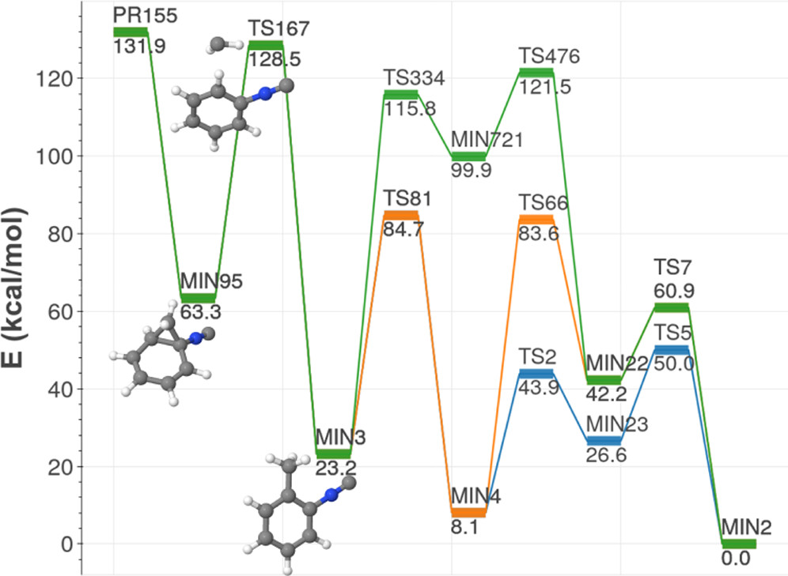
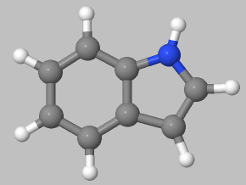
Formation of indole in the ISM
ACS Phys. Chem. Au 2022, 2, 225
CH₂+C₆H₅NC
CCSD(T)/aug-cc-pVTZ//M06-2X/MG3S

